Slide 1
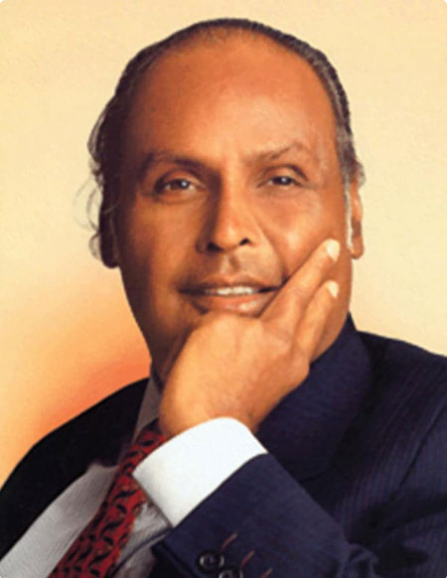
Dhirajlal Hirachand Ambani
Founder of Reliance Industry
Born in dec 1932
Died on July 2002 (age of 69)

Slide 2
1. About Dhirubhai Ambani
Dhirubhai Ambani (born December 28, 1932, Chorwad, Gujarat, India—died July 6, 2002, Mumbai, India) was an Indian industrialist who was the founder of Reliance Industries, a giant petrochemicals, communications, power, and textiles conglomerate that was the biggest exporter in India and the first privately owned Indian company in the Fortune 500.
India, Dhirubhai Ambani lived and worked in Aden (which is now part of Yemen) . He Moved to Aden for better work opportunities in around 1948-49 . He first worked as a gas station attendant at a Shell filling station. Later He worked as a clerk for A. Besse & Co., a large transcontinental trading firm.

Slide 3
2. Early Stage of Reliance Industry
1958 - 1980
Reliance Commercial Corporation was set up in 1958 by Dhirubhai Ambani as a small venture firm trading commodities, especially spices and polyester yarn. In 1965, the partnership ended and Dhirubhai continued the polyester business of the firm. In 1966, Reliance Textiles Industries Pvt. Ltd. was incorporated in Maharashtra. It established a synthetic fabrics mill in the same year at Naroda in Gujarat. On 8 May 1973, it became Reliance Textiles Industries Limited. In 1975, the company expanded its business into textiles, with "Vimal" becoming its major brand in later years. The company held its initial public offering (IPO) in 1977. The issue was over-subscribed by seven times.^{[19]} In 1979, a textiles company Sidhpur Mills was amalgamated with the company. In 1980, the company expanded its polyester yarn business by setting up a Polyester Filament Yarn Plant in Patalganga, Raigad, Maharashtra with financial and technical collaboration with E. I. du Pont de Nemours & Co., U.S.

Slide 4
3. key achievements of Reliance Industries Limited (RIL)
1. Created an equity-investment culture in India. (1977)
2. Built the Jamnagar refinery. (2000)
3. Became a global petrochemicals leader.
4. Revolutionised Indian telecom with Jio.
5. Built a massive digital platform.
6. Became India’s largest retailer.
7. Reached global corporate scale.
8. Crossed major financial milestones .
9. Invested heavily in New Energy.
10. Strong contribution to society.

Slide 5
4. Struggles Faced by Reliance Industries Limited
Limited initial resources:- The company started on a relatively small scale and had to compete with established businesses.
Highly regulated business environment:- India’s industrial environment during the early years involved licensing regulations and restrictions.
Competition from established companies:- Reliance entered industries where larger and more experienced companies were already operating.
Capital requirements:- Expansion into manufacturing , petrochemicals , refining and telecommunications required extremely large investments.
Technological and operational challenges:- building large – scale industrial facilities required advanced technology , skilled employees , efficient supply chains and strong management.

Slide 6
5. Entrepreneurial Traits of Reliance Industries
Visionary leadership – Reliance has consistently focused on long-term goals and large-scale opportunities rather than short-term gains.
Innovation – The company has adopted new technologies and entered emerging sectors such as telecommunications, digital services, artificial intelligence and new energy.
Risk-taking ability – Reliance has undertaken large investments in industries involving substantial financial, operational and market risks, while maintaining formal risk-management systems.
Diversification – It has expanded beyond textiles into petrochemicals, refining, telecom, retail, digital services and new energy, reducing dependence on a single business.
Opportunity recognition – Reliance identifies major consumer and economic needs in India and attempts to address them on a very large scale.

Slide 7
5. Entrepreneurial Traits of Reliance Industries
6. Customer orientation – Businesses such as Jio and Reliance Retail focus on providing affordable, accessible and technology-driven products and services to a large customer base.
7. Large-scale thinking – A major characteristic of Reliance is its ability to build businesses and infrastructure at enormous scale, supported by strong project execution capabilities.
8. Adaptability – Reliance has repeatedly reinvented its business strategy as markets and technologies have changed.
9. Long-term investment – The company is willing to make substantial investments today for future growth, including investments in new energy and advanced technologies.
10. Entrepreneurial culture – Reliance encourages employees to identify opportunities and take initiatives while using structured risk-management and governance systems.

Slide 8
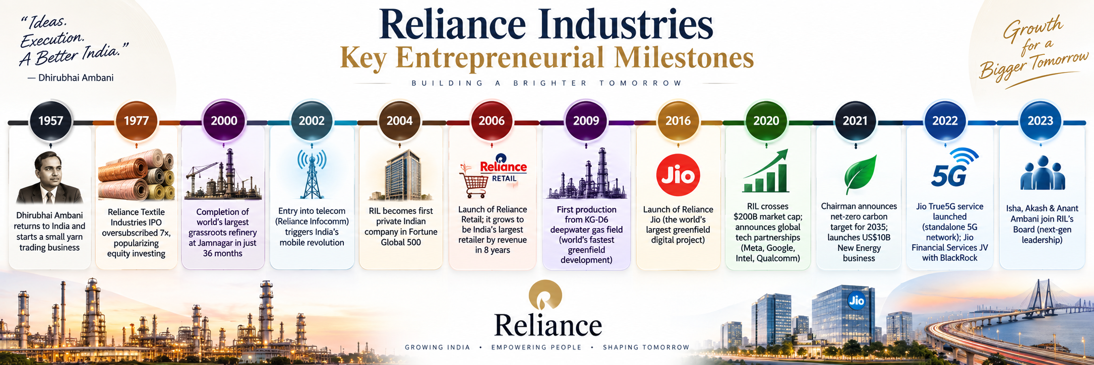

Slide 9
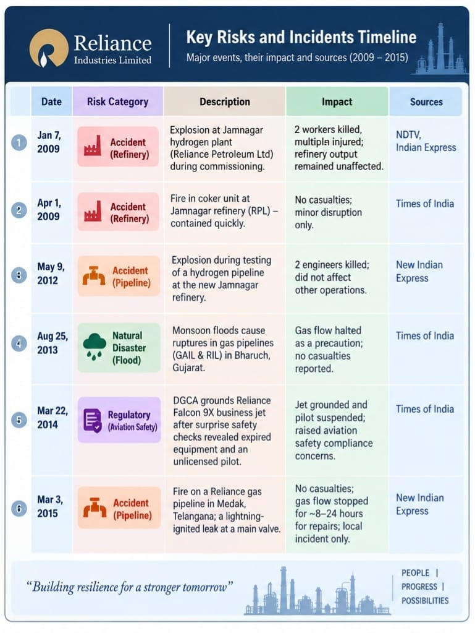
6. Risks and Crises of Reliance Industry

Slide 10
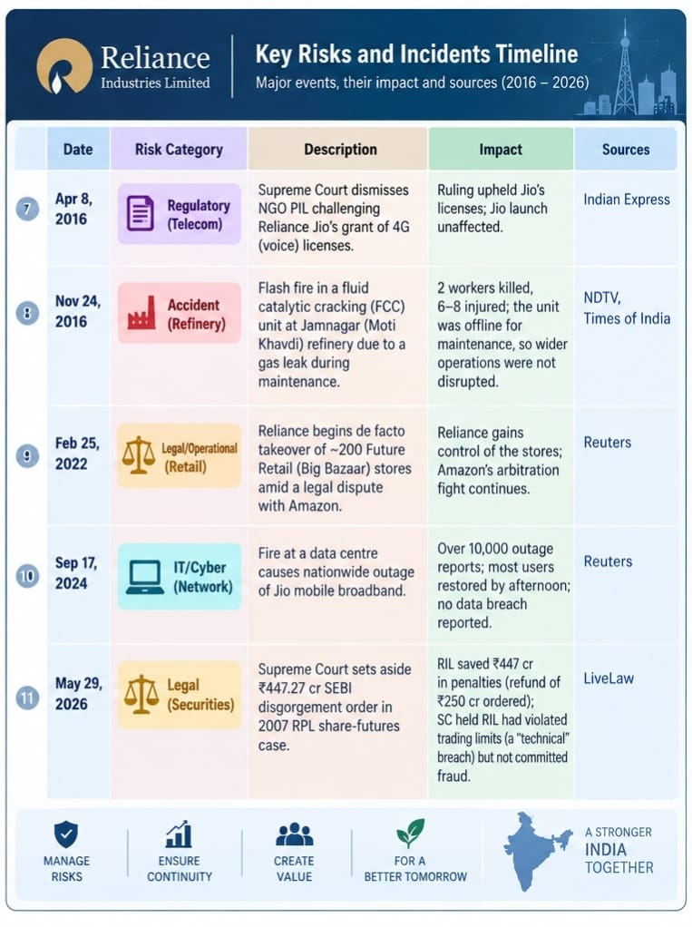
6. Risks and Crises of Reliance Industry

Slide 11
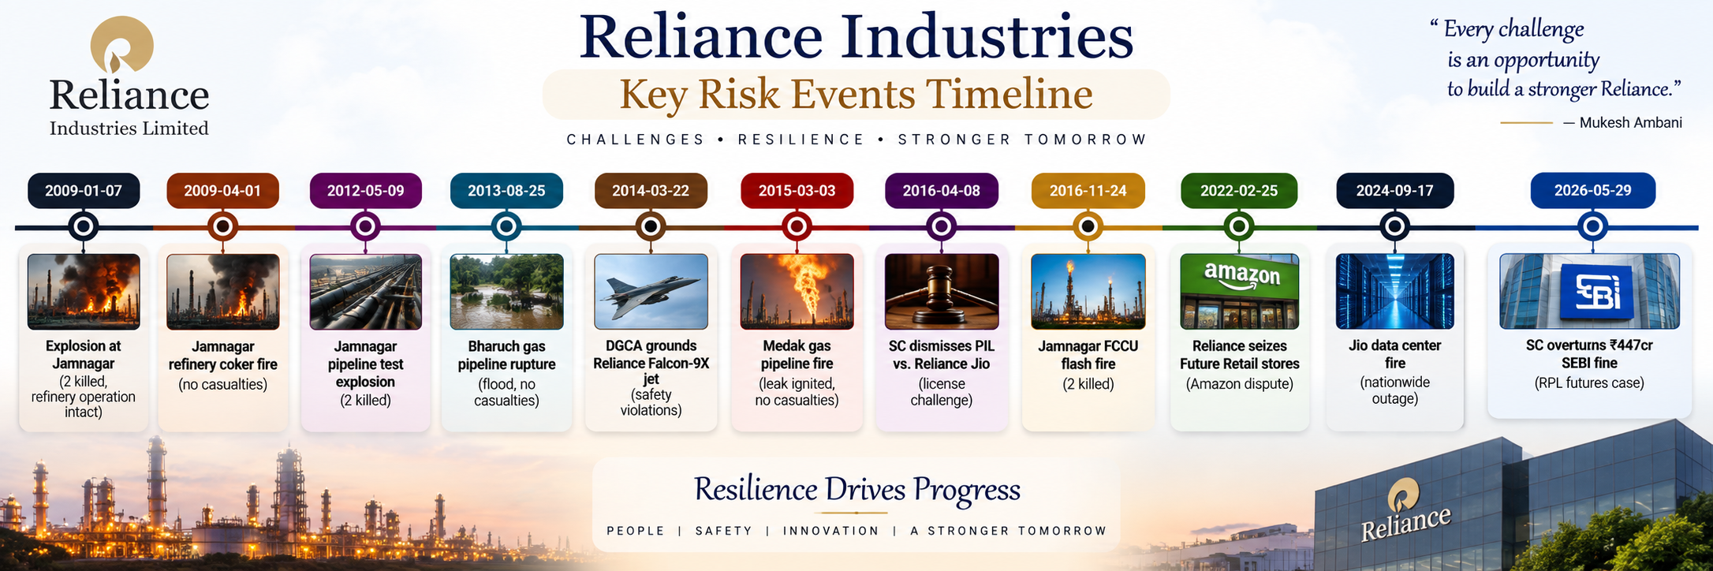

Slide 12
5. Conclusion
The Case Study of Reliance Industries demonstrates that entrepreneurial success is not achived only through a good business idea. It requires vision , courage , strategies , planning , innovation , adaptability , and continuous investment . Dhirubhai Ambani Transformed a small trading venture into the foundation of one of India’s largest business enterprises. His ability to think big , take calculated risks , raise capital and integrate different stages of production played a crucial role in Reliance’s early growth.

Slide 13
Thank You

